Slide 1
CRP 2.0 Assignment Demo Trung Nguyen – DevOps Enginner
Key Techniques
Cloud provider: Azure
IaC tool: Terraform
Pipeline: Github Action, Jenkins, ArgoCD
Source code: Github
Container images: Azure Container Registry
Blue/Green Strategy: Argo Rollouts

Slide 2
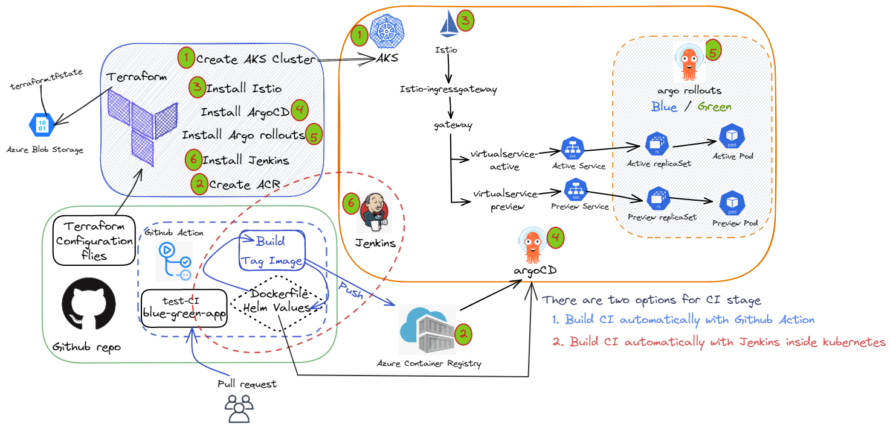
Diagram

Slide 3
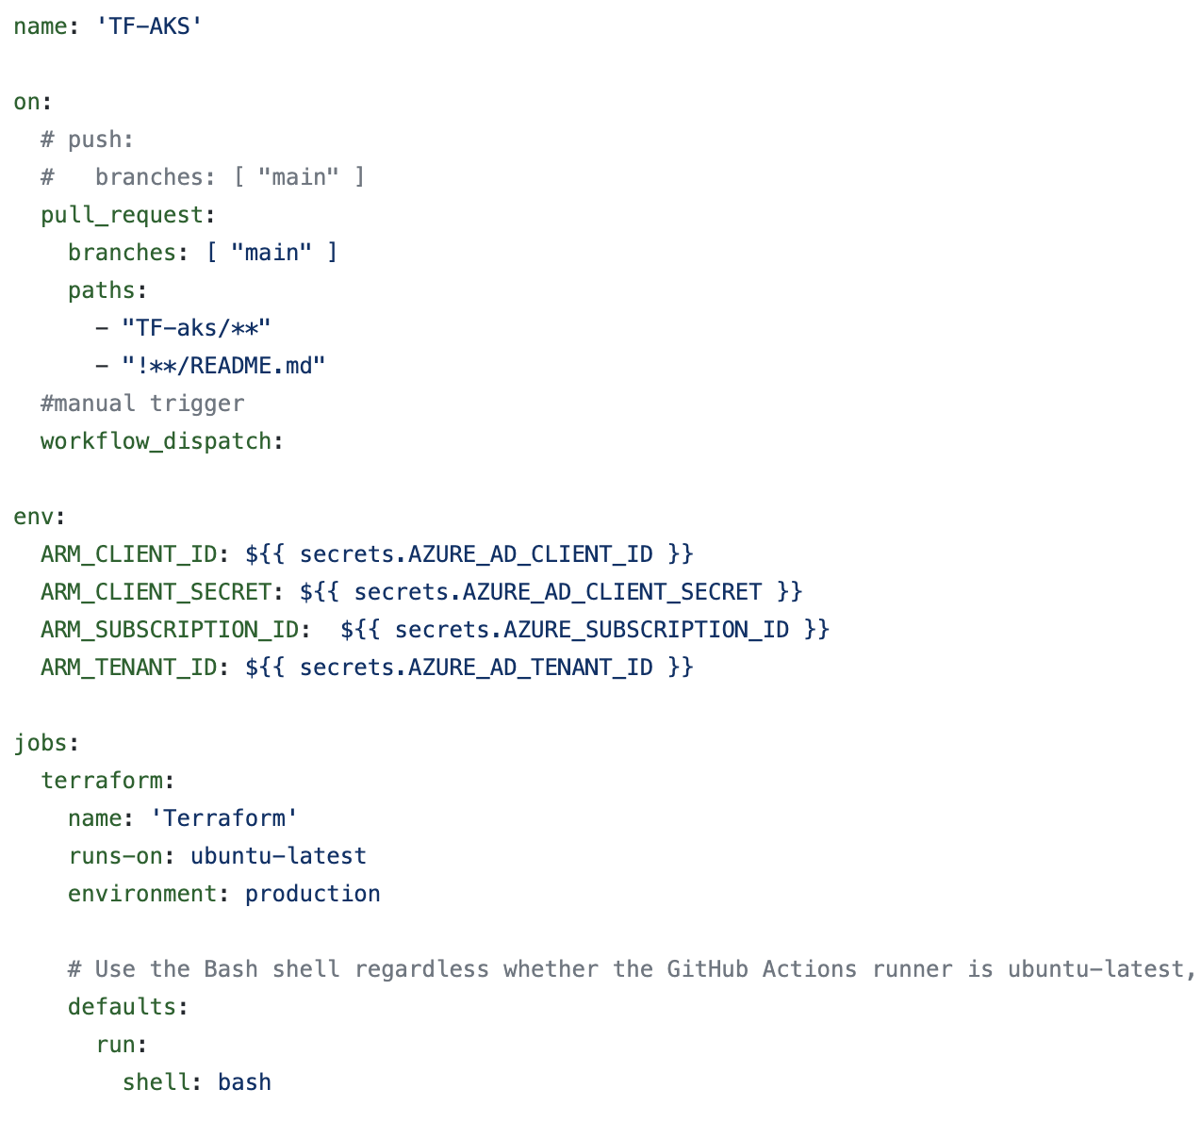
Terraform Create AKS & ACR
Auto trigger once pull request merged, and manual run
All secret for Azure stored in Github Secret
Information of Runner

Slide 4
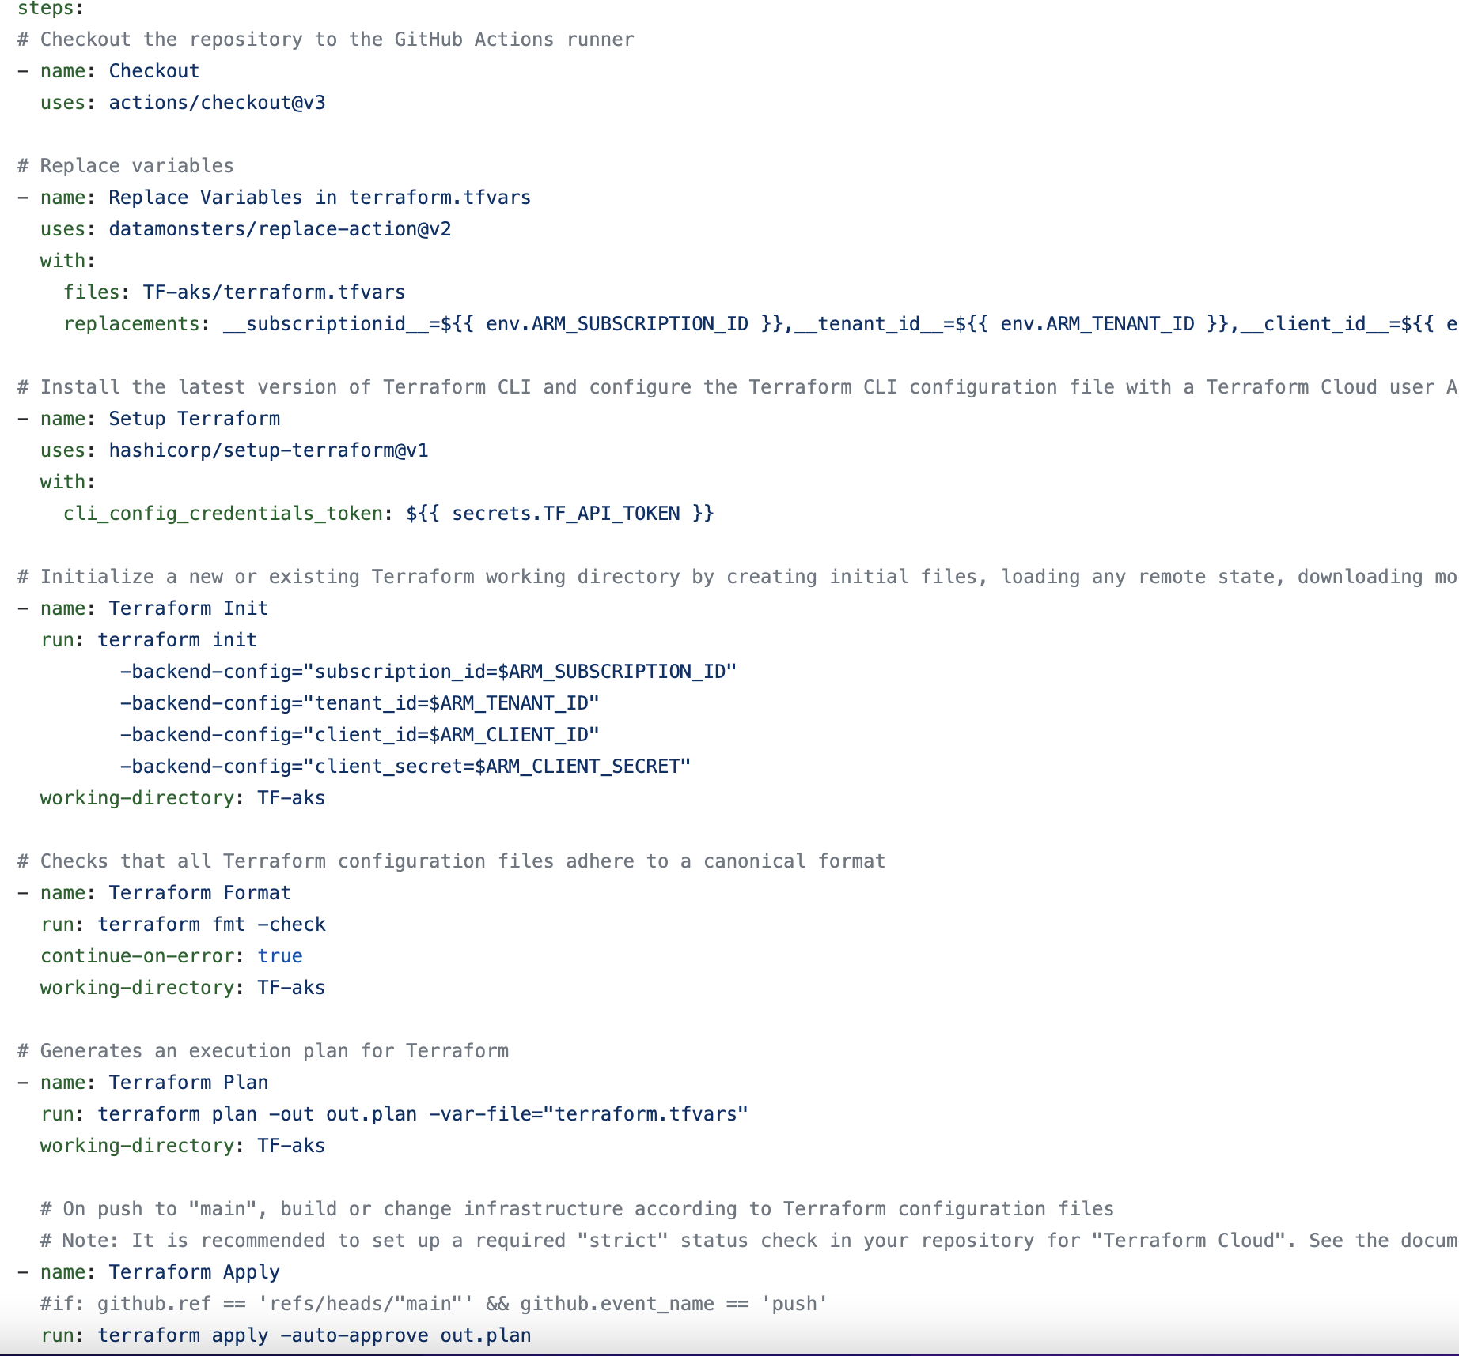
Terraform Create AKS & ACR
Step checkout source code
Replace variables in TF with ENV variables
Setup terraform tool
Terraform init
& format
& plan
& apply
There will be another terraform destroy (command line out)

Slide 5
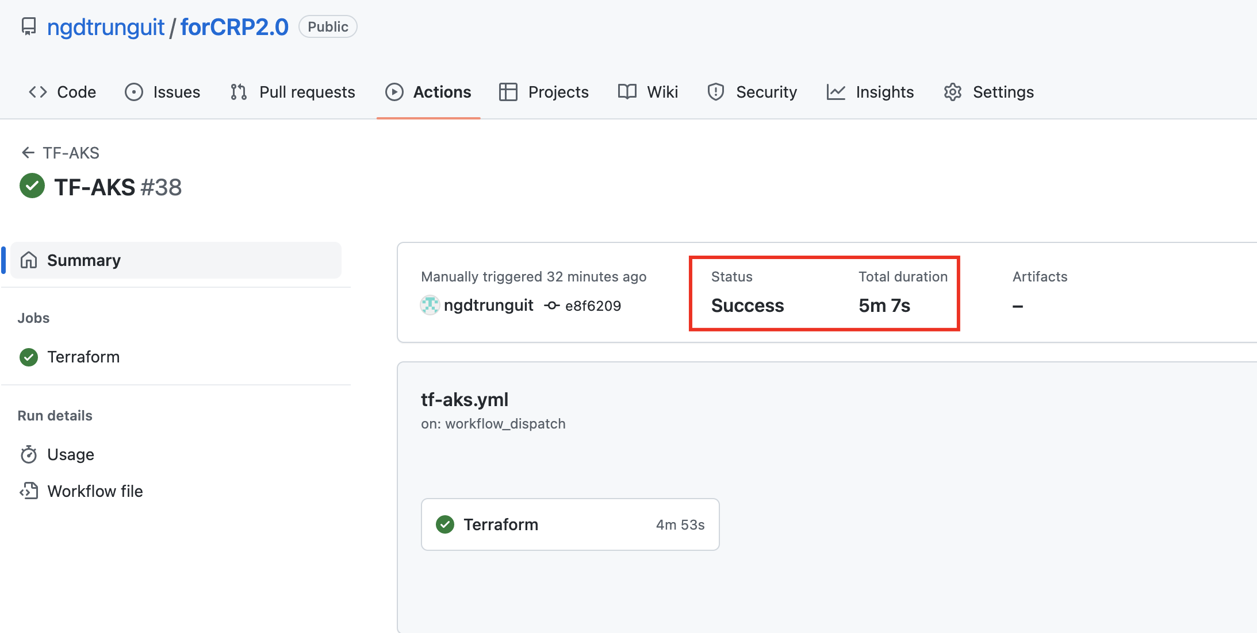
Terraform Create AKS & ACR

Slide 6
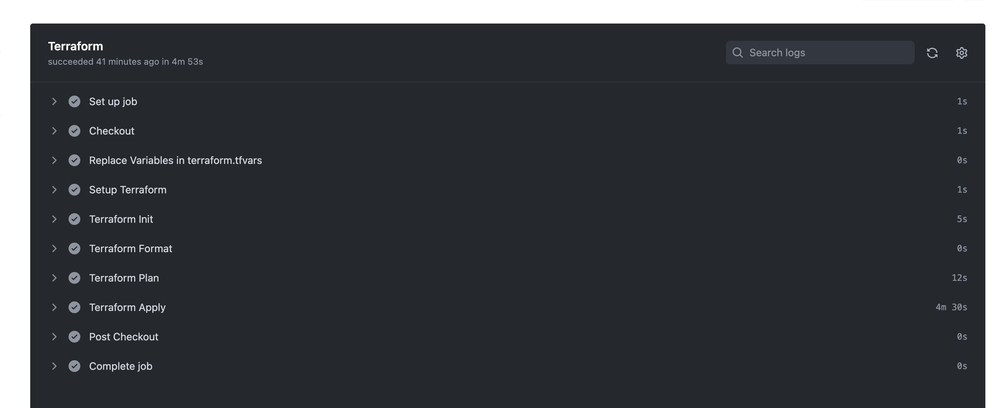
Terraform Create AKS & ACR

Slide 7
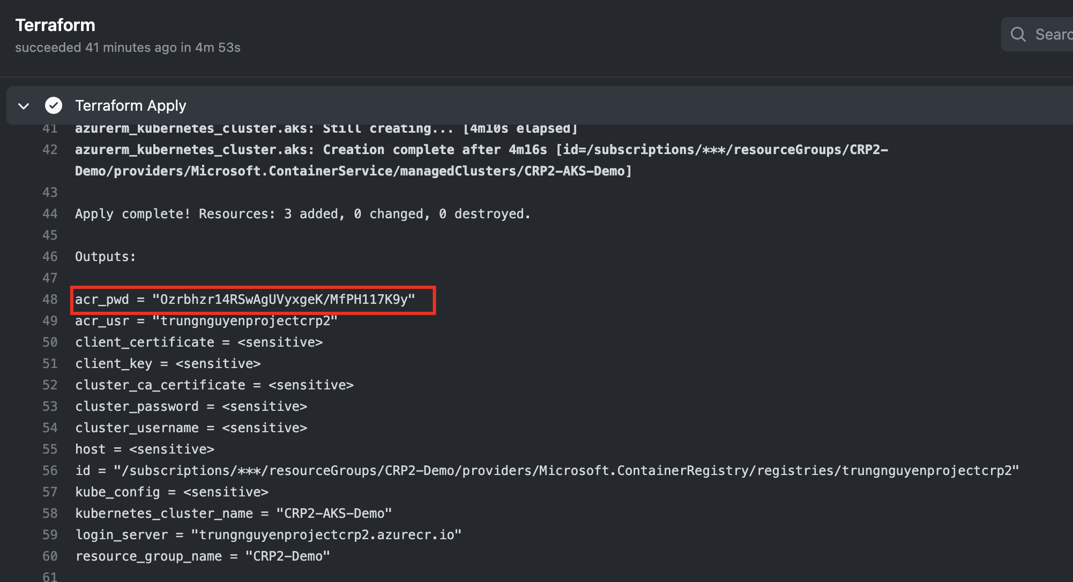
Terraform Create AKS & ACR

Slide 8
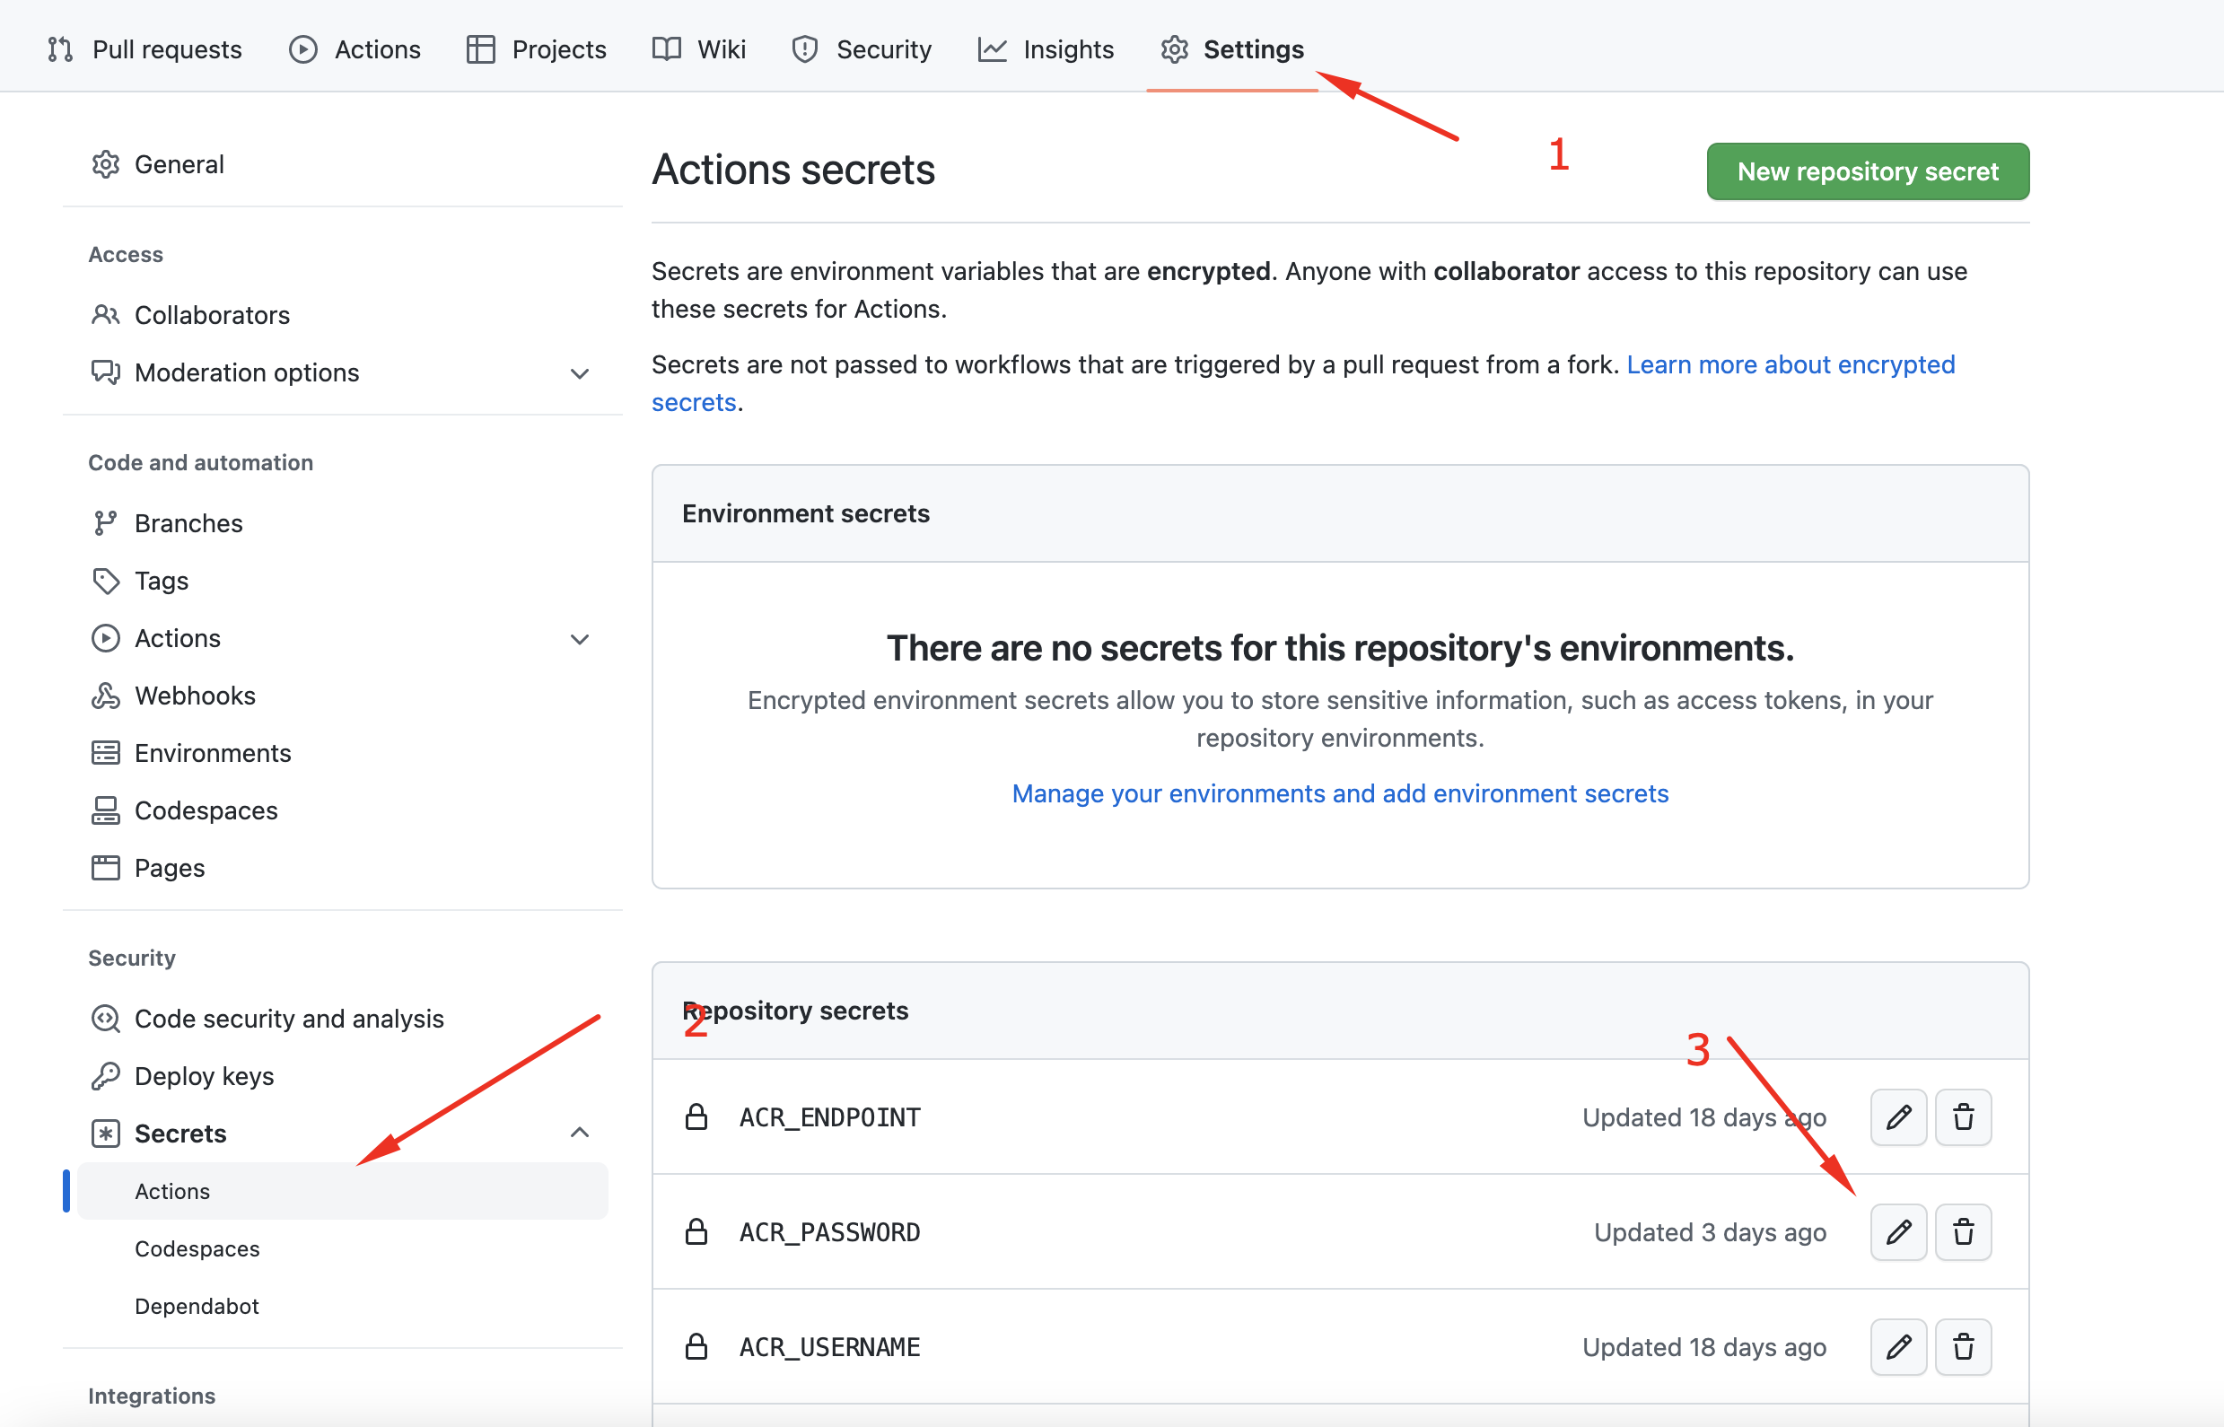
Terraform Create AKS & ACR
Update ACR_PASWORD

Slide 9
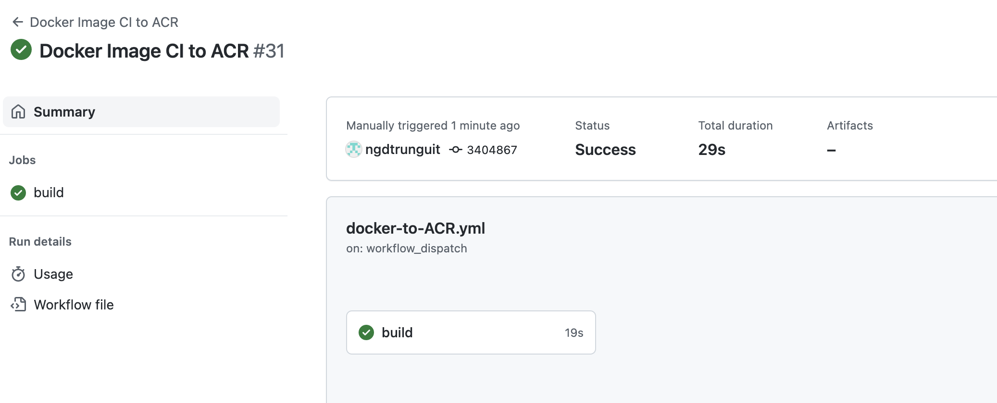
Using Github Action to build CI
Trigger built CI successfully

Slide 10
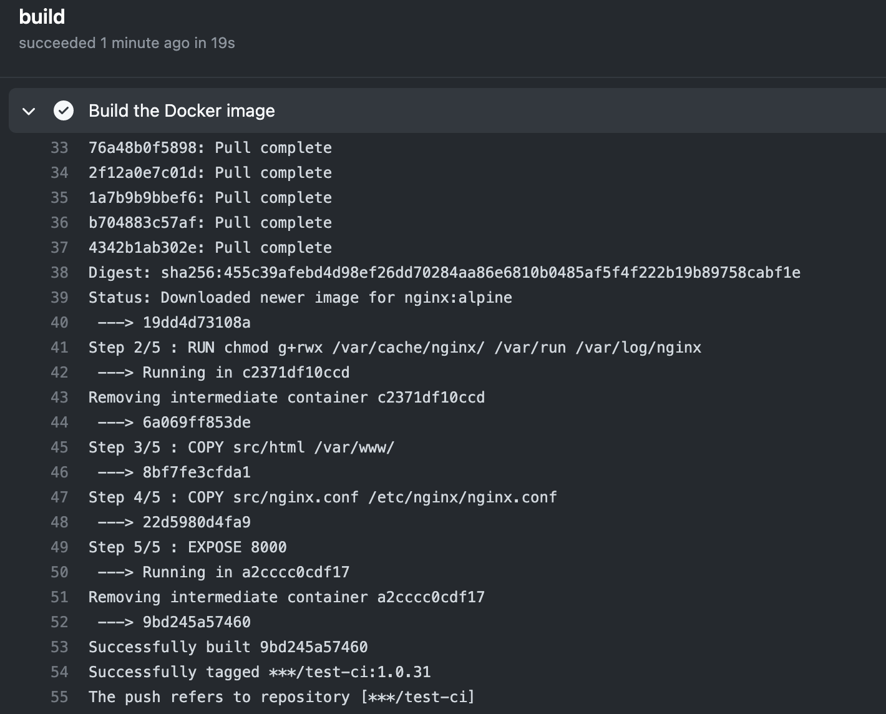
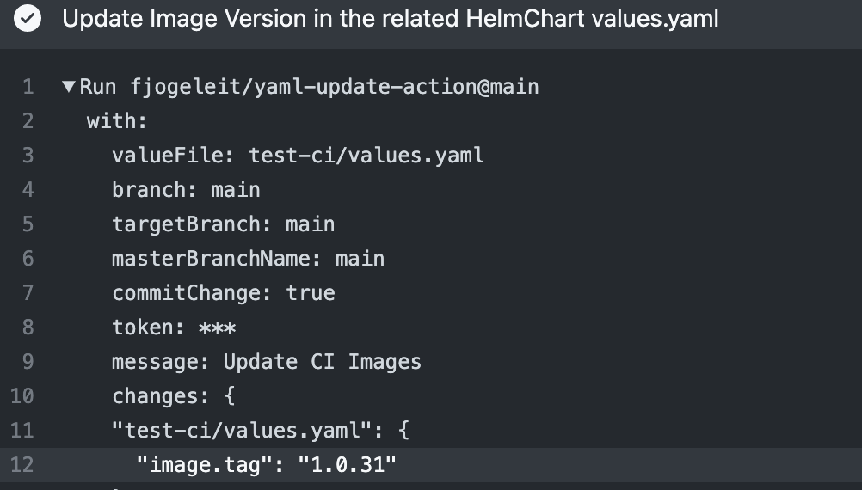
Using Github Action to build CI
Update CI tag number to Values.YAML

Slide 11
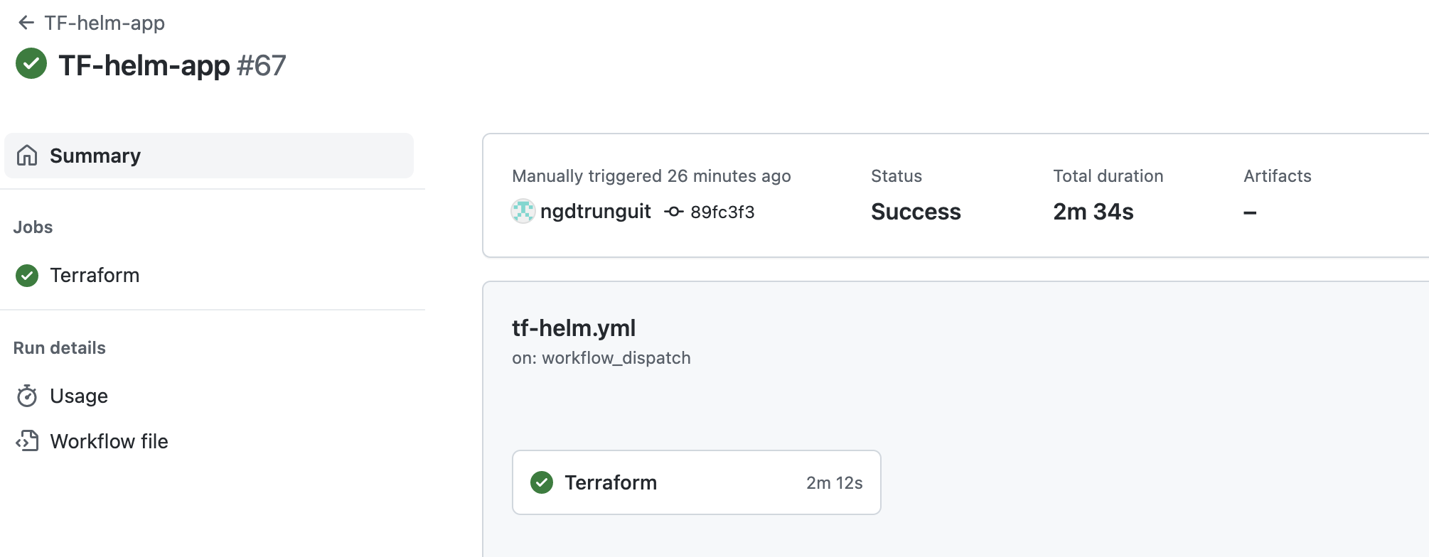
Terraform Install ArgoCD, Argo Rollouts, Jenkins by Helm
Install all components successfully

Slide 12
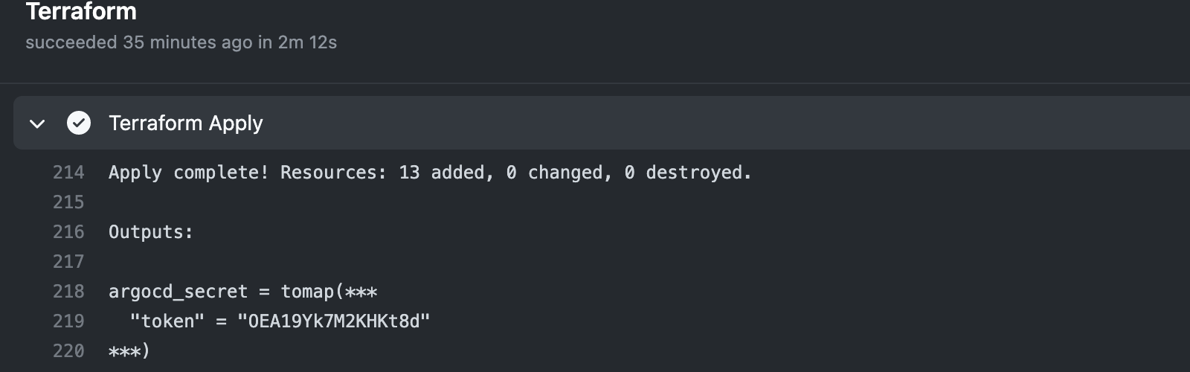
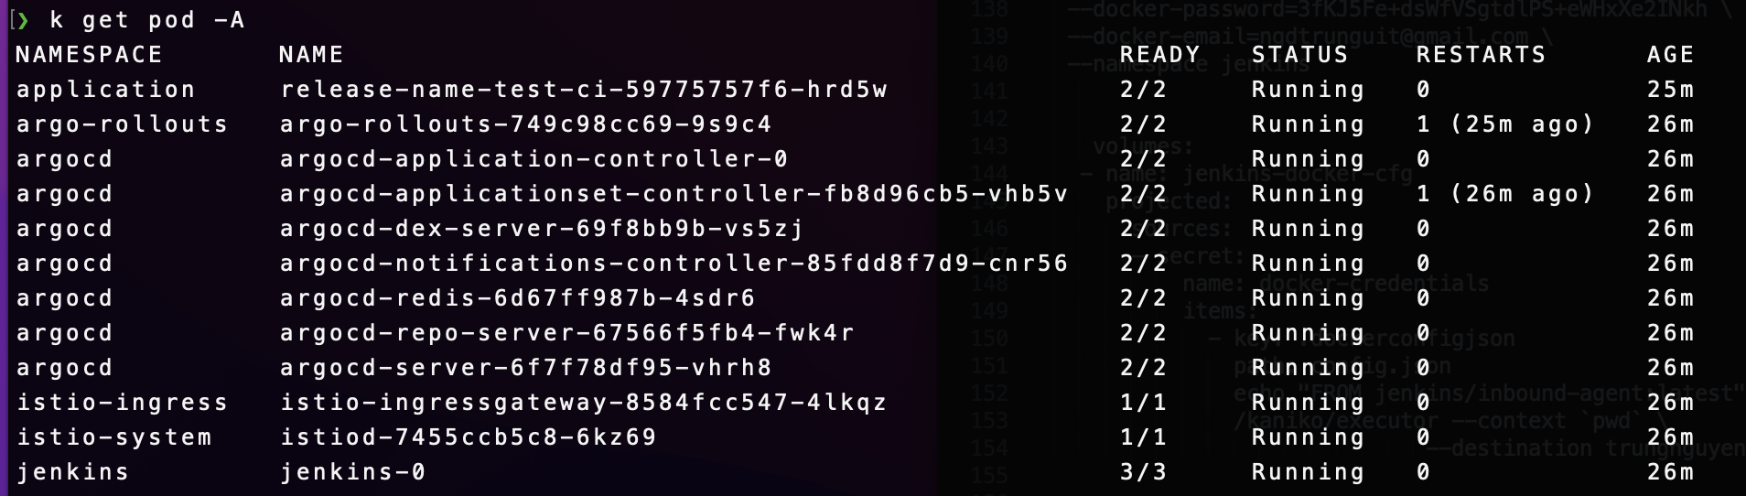
Terraform Install ArgoCD, Argo Rollouts, Jenkins by Helm
-> Output argocd_secret for login

Slide 13
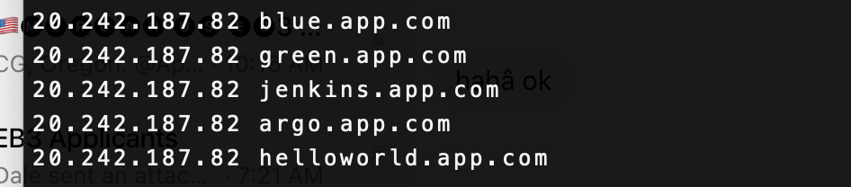
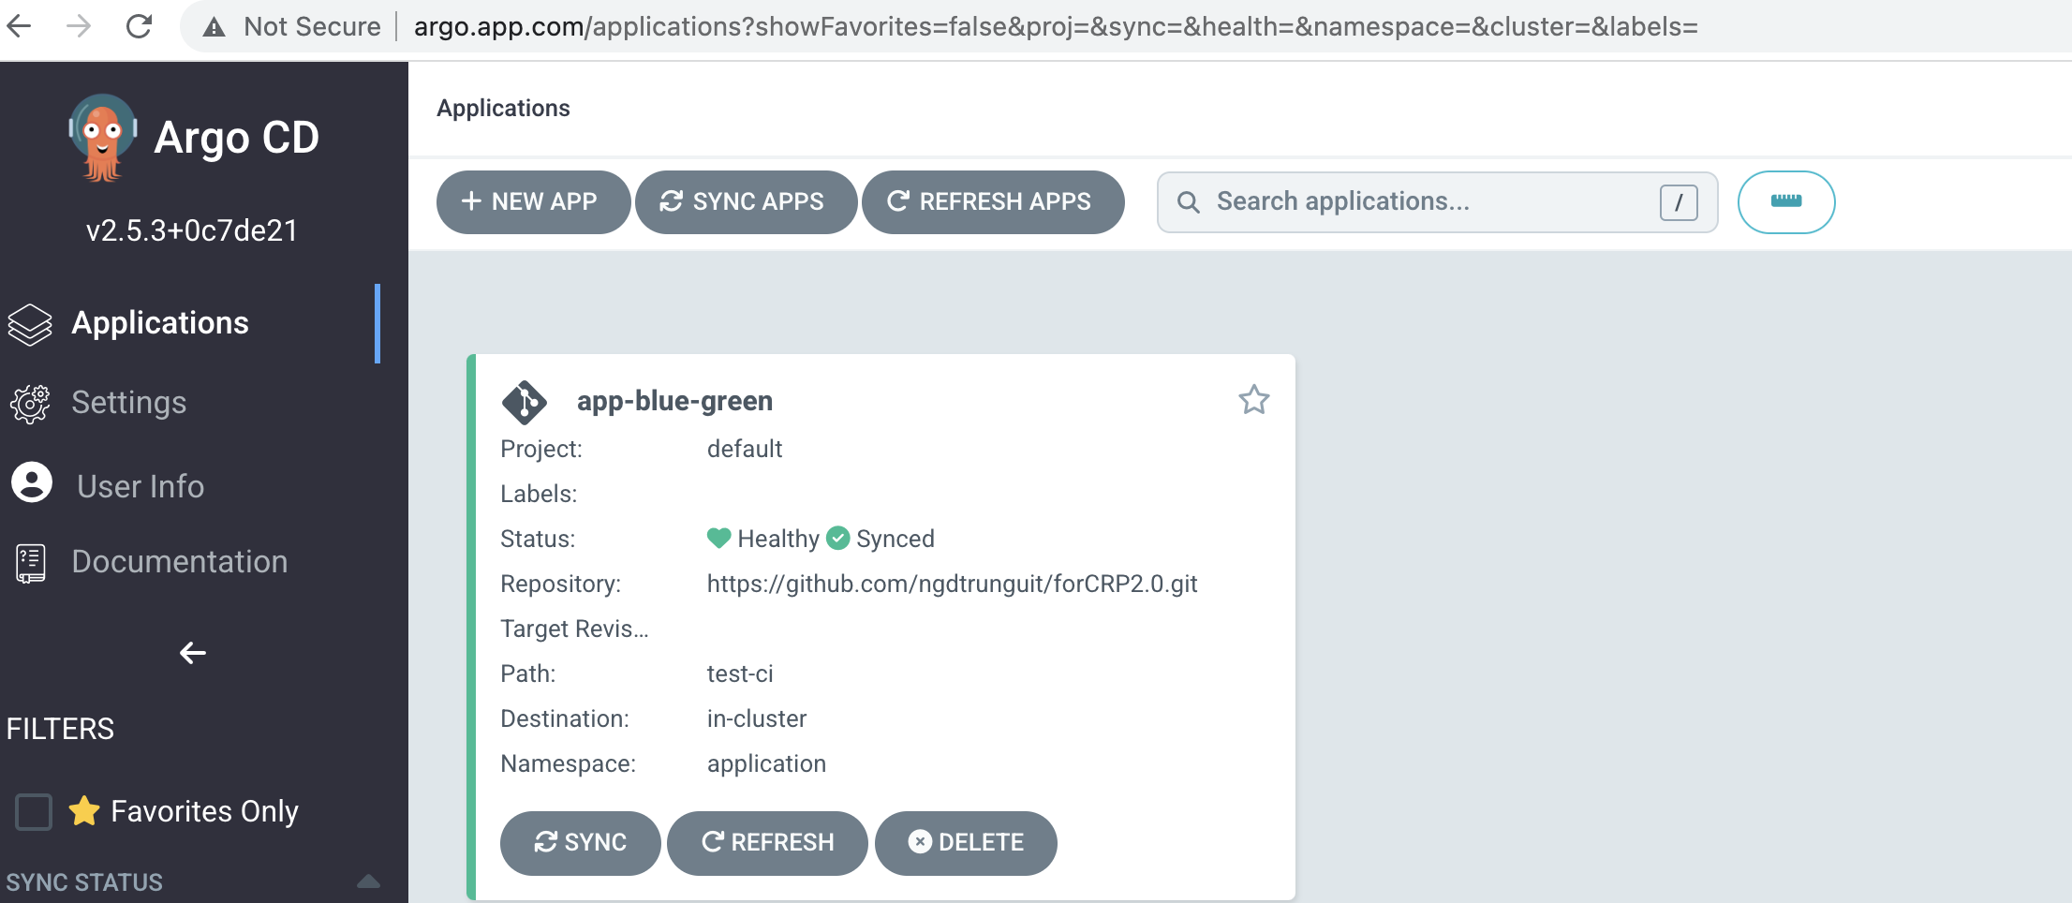
Terraform Install ArgoCD, Argo Rollouts, Jenkins by Helm
-> Add loadbalancer address to host files
Login to argoCD app successfully

Slide 14
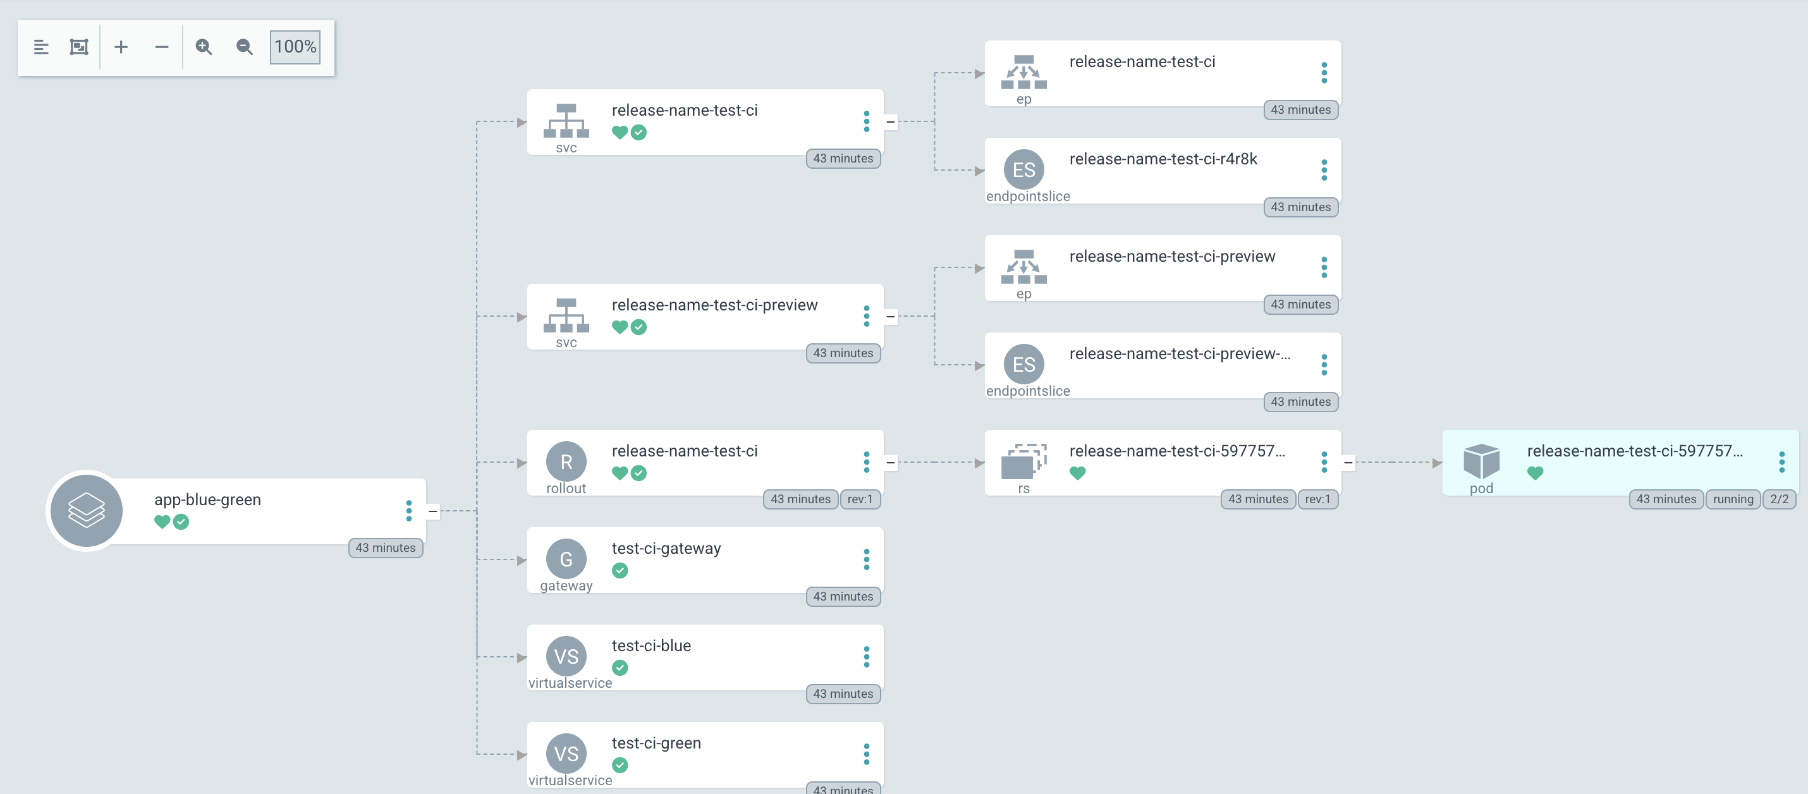
Terraform Install ArgoCD, Argo Rollouts, Jenkins by Helm

Slide 15
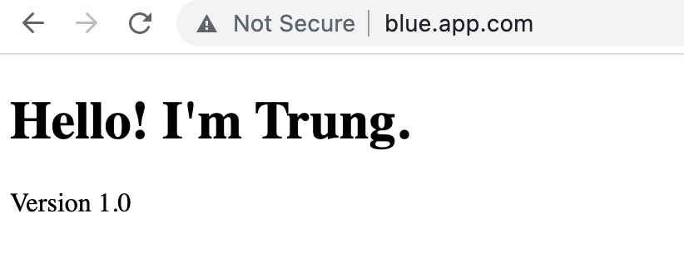
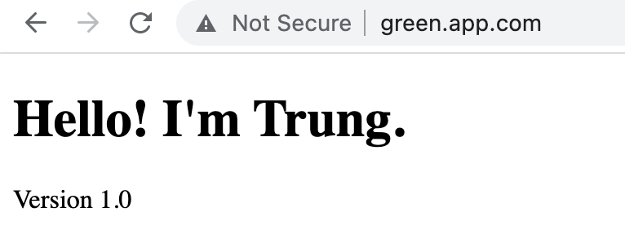
Terraform Install ArgoCD, Argo Rollouts, Jenkins by Helm
Blue Green application up and running – Version 1.0

Slide 16
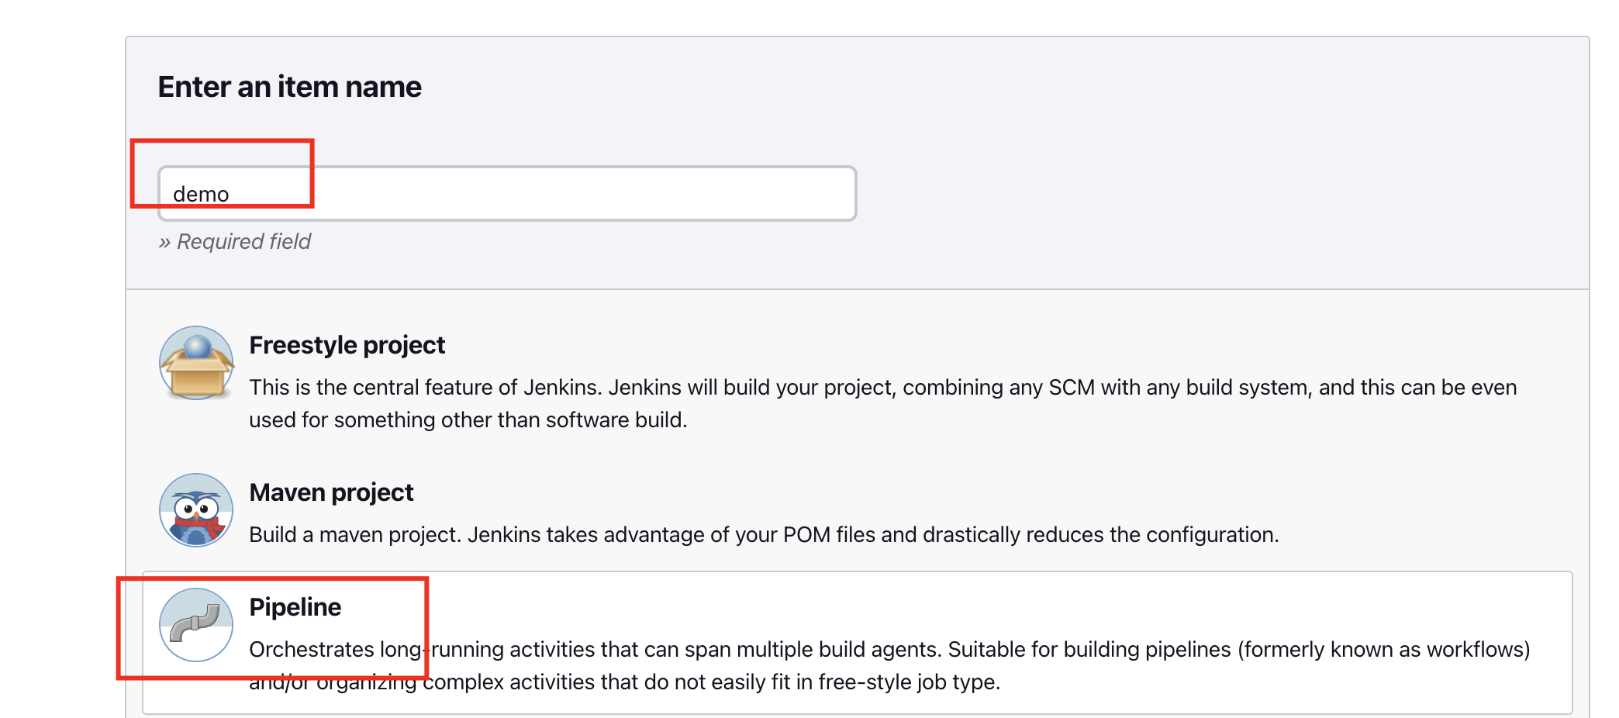
Create Jenkins job for CI Build

Slide 17
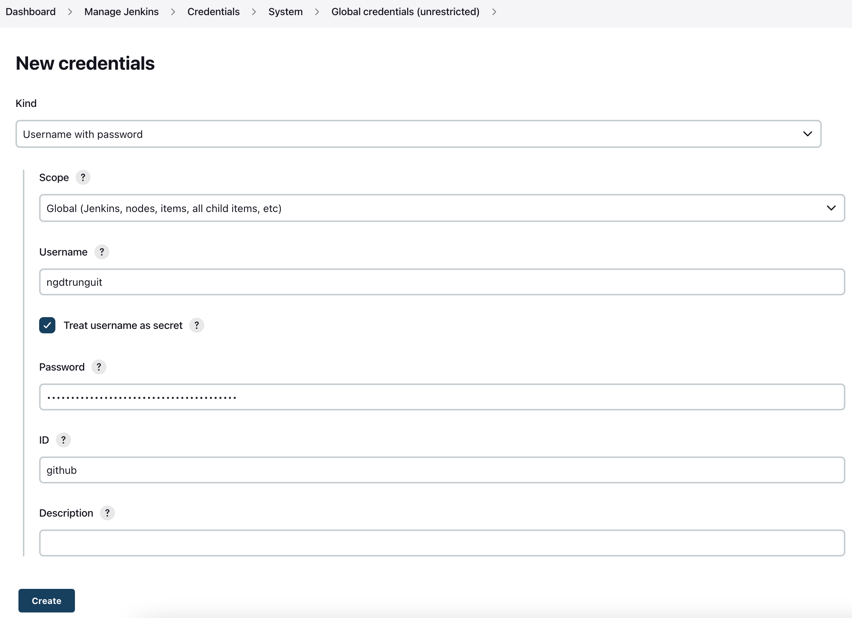
Create Jenkins job for CI Build
Add github credential to Jenkins

Slide 18
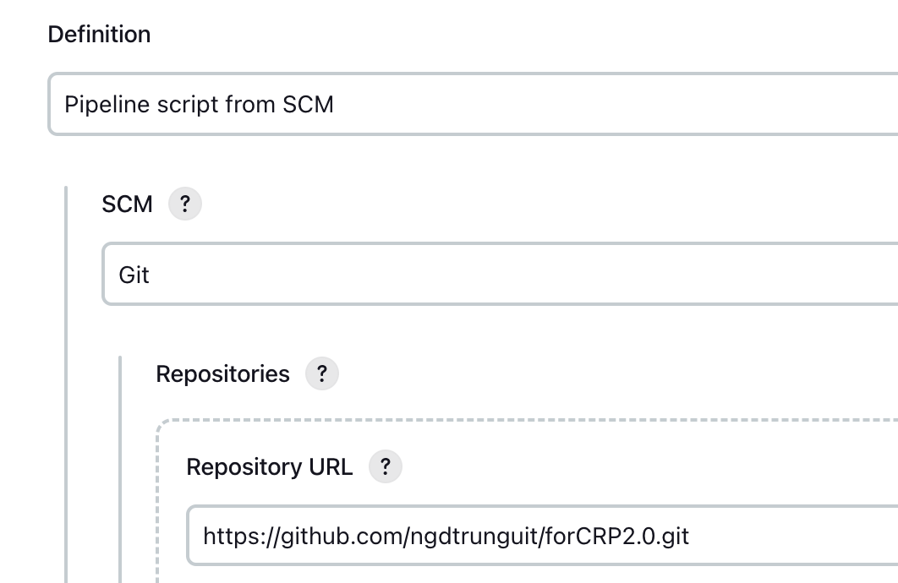
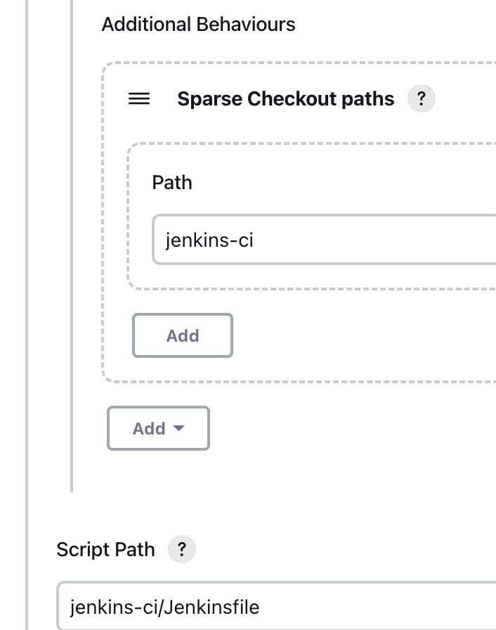
Create Jenkins job for CI Build

Slide 19
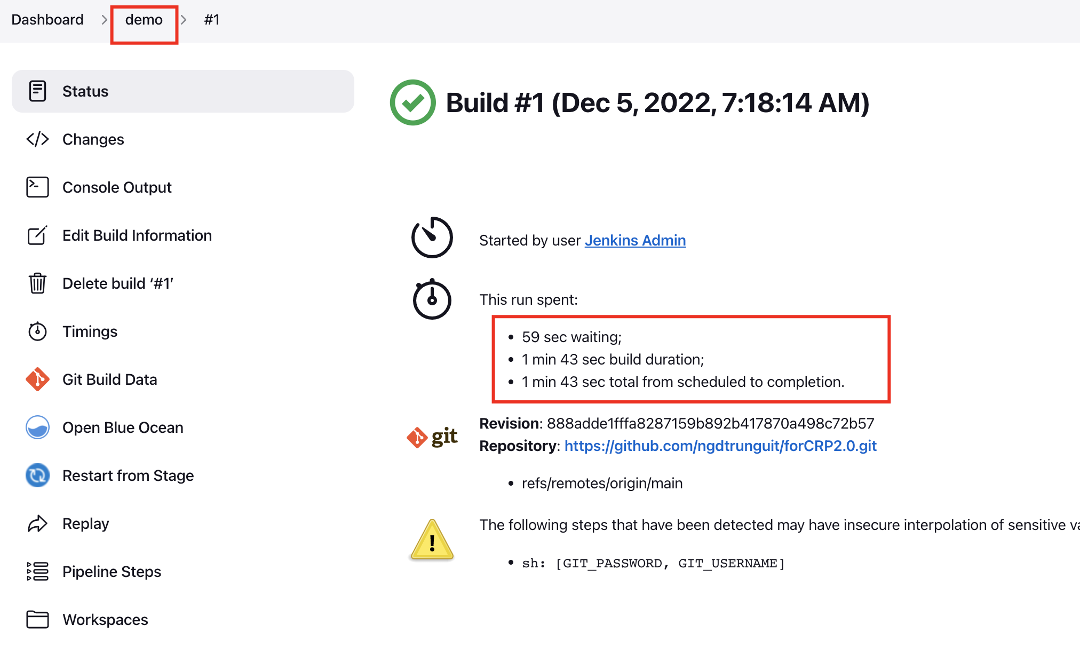
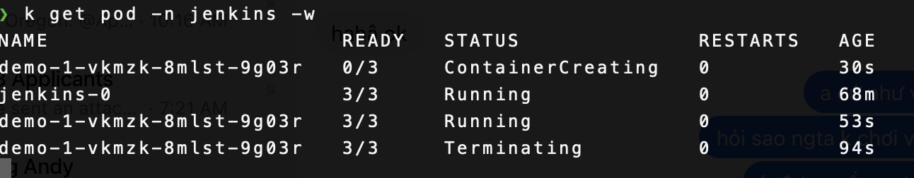
Create Jenkins job for CI Build
Job was created and ran successfully
Describe how jenkins worker runner on K8s

Slide 20
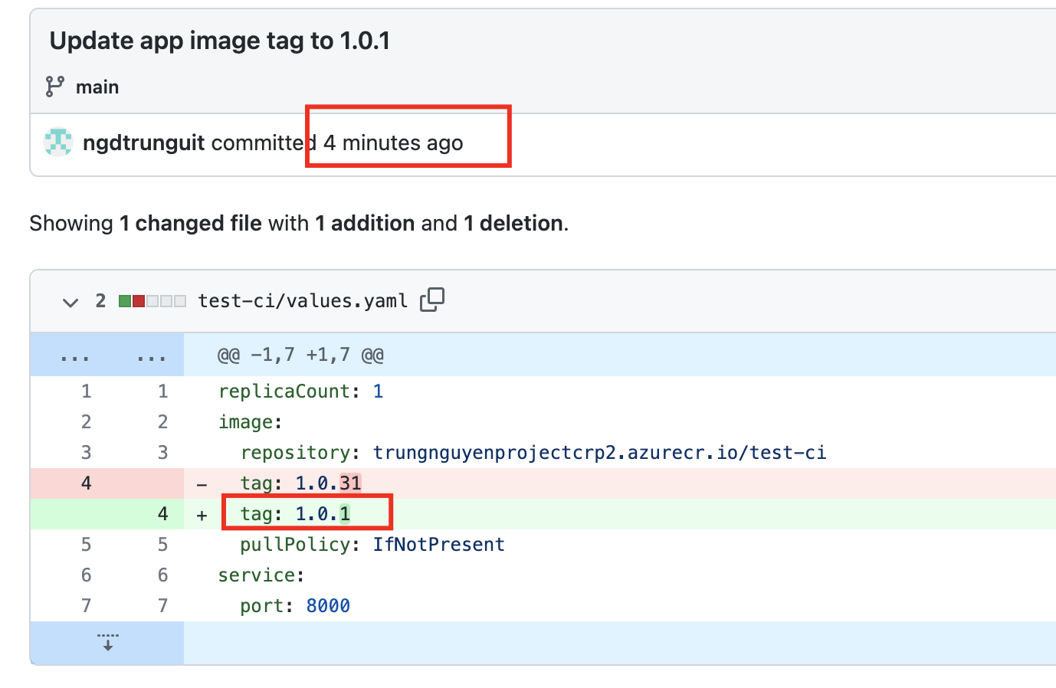
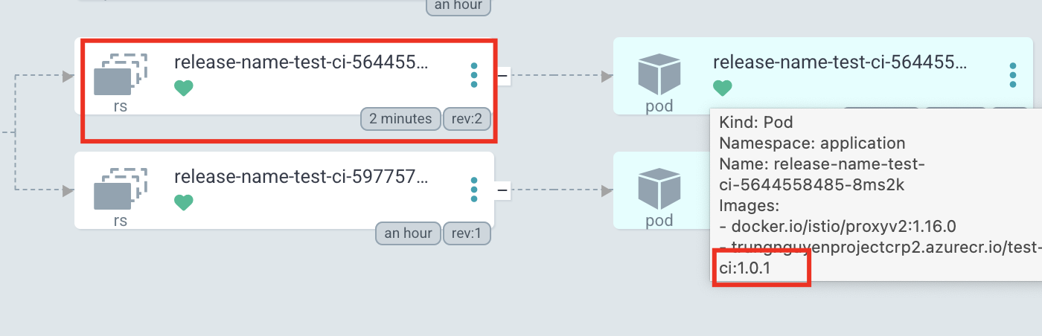
Create Jenkins job for CI Build
Image was updated automatically
to values.yaml of helm repo
ArgoCD sync the new change of values

Slide 21
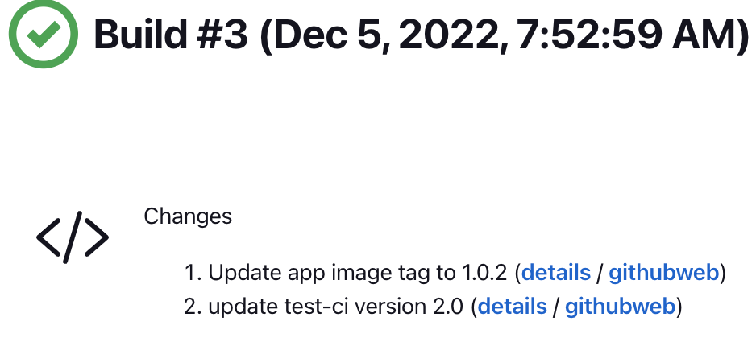
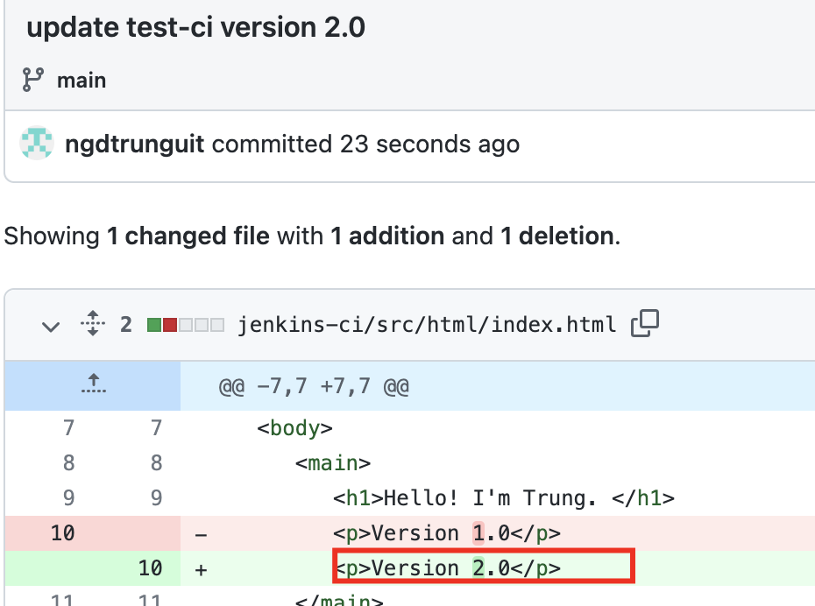
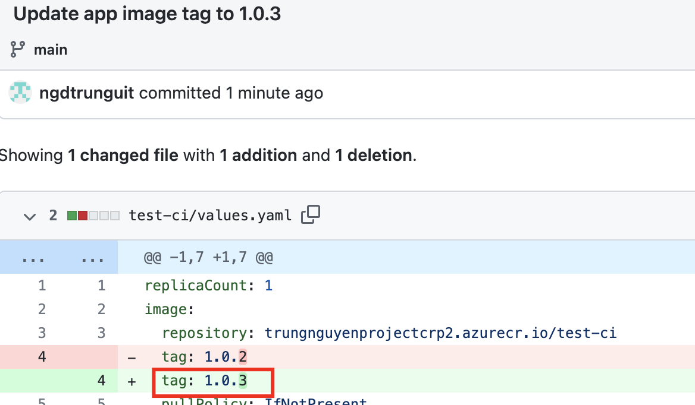
Test Blue Green Strategy by Argo rollouts
Modify application to Version 2.0
-> Trigger Jenkins build for new version
-> Jenkins build success and automatically tag new version
to values.yaml of helm chart.

Slide 22
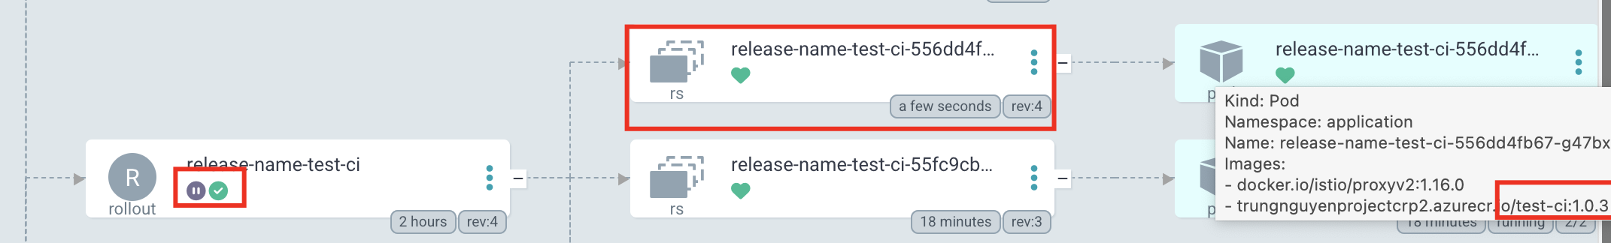
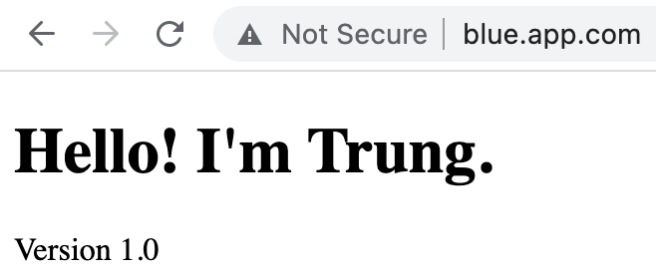
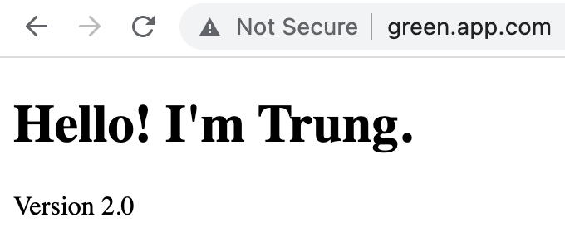
Test Blue Green Strategy by Argo rollouts
Argo CD sync the new changes, Argo rollouts automatically create new replicaSet for previewing on green.app.com
→ blue.app.com is still running version 1.0
→ While green.app.com is running version 2.0 for testing and confirm from Q/A

Slide 23
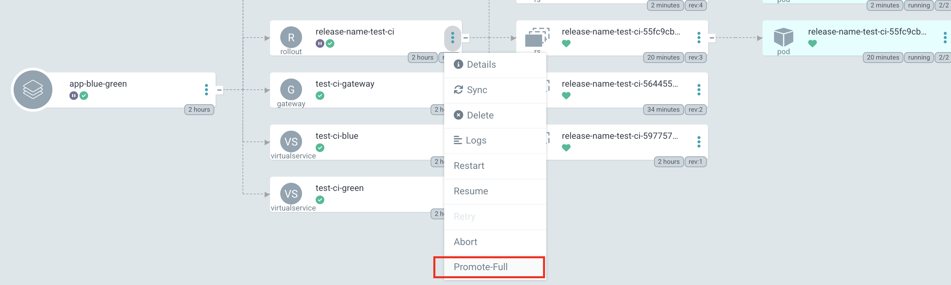
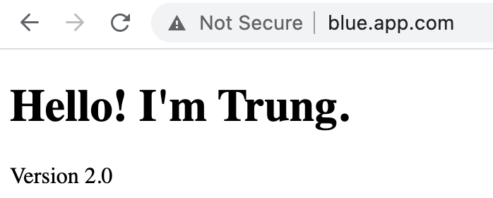
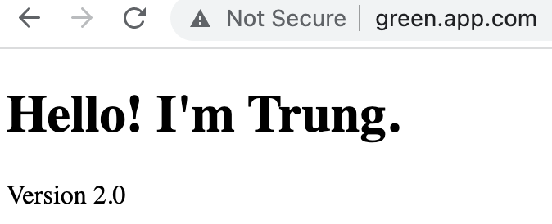

Test Blue Green Strategy by Argo rollouts
Once Q/A confirm the version 2.0 working properly, we can press Promote-Full, replicaSet of the version 1.0 will scale down
to 0 and we have both blue.app.com and green.app.com are showing version 2.0

Slide 24
Thank you for listening!

